Slide 1
MAHINDRA DEALER Management System
-By WYH Team

Slide 2
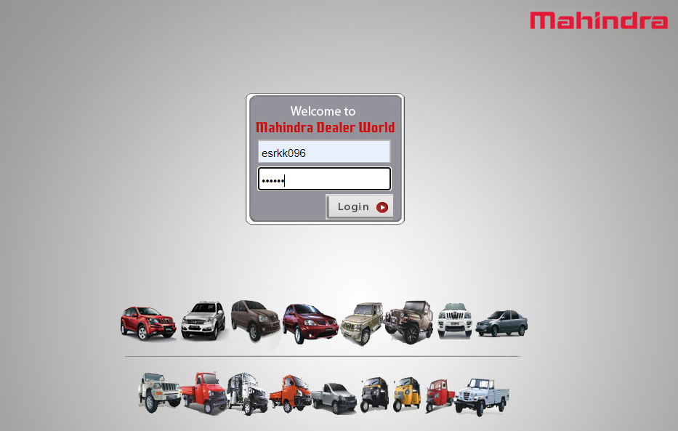
DMS – Dealer Management system
URL – https://Mahindra & Mahindra Dealer Business World

Slide 3
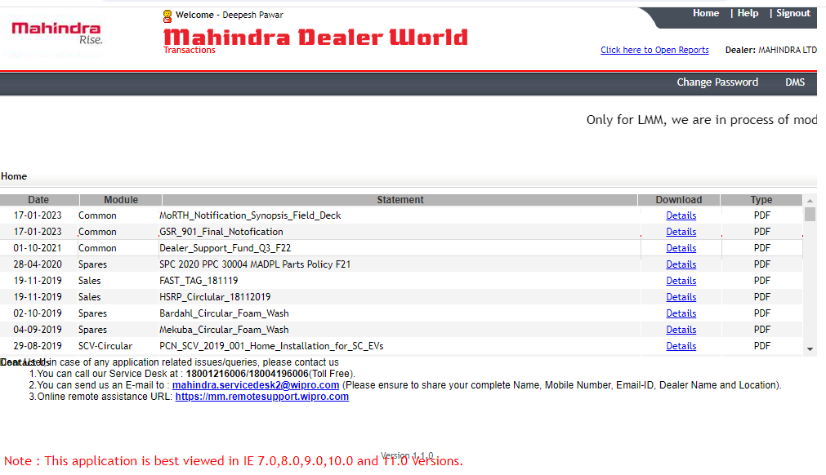
DMS Screen - Home Screen of DMS
How to check the vehicle details
Step1: Click on “DMS” (Right hand side)

Slide 4
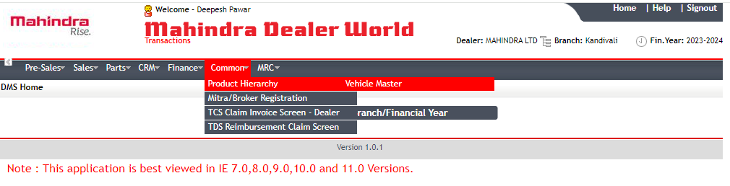
DMS
Steps to check the vehicle details
1: Post clicking on “DMS”
2: Click on “Common”
3: select “Product hierarchy” from drop down
4: Then select “Vehicle Master”

Slide 5
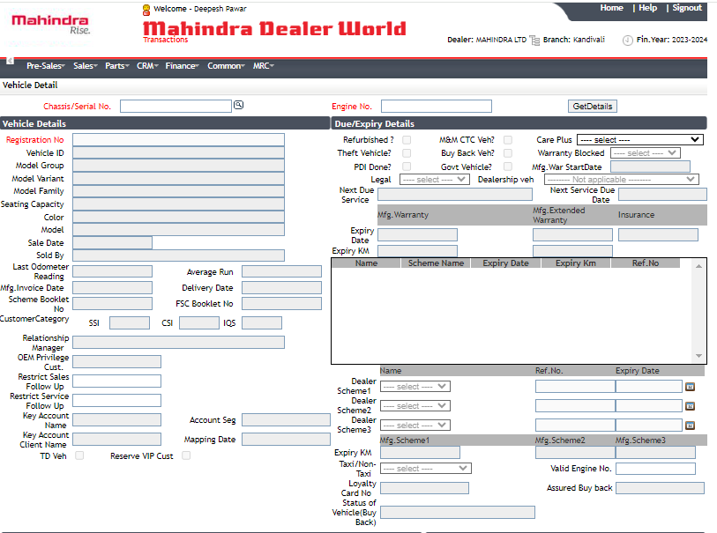
Click on “Search icon”
Then you will get a pop up to put the vehicle details

Slide 6
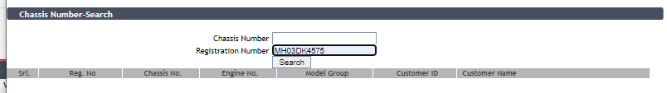
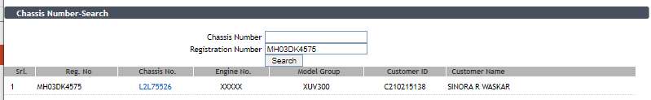
We can check the vehicle details from “Chassis Number” & Registration number”
Note: we need last 8 digit of chassis number
Click on “Search” for vehicle details
We will get the details and we have to click on hyperlink which is available under “Chassis No.”

Slide 7
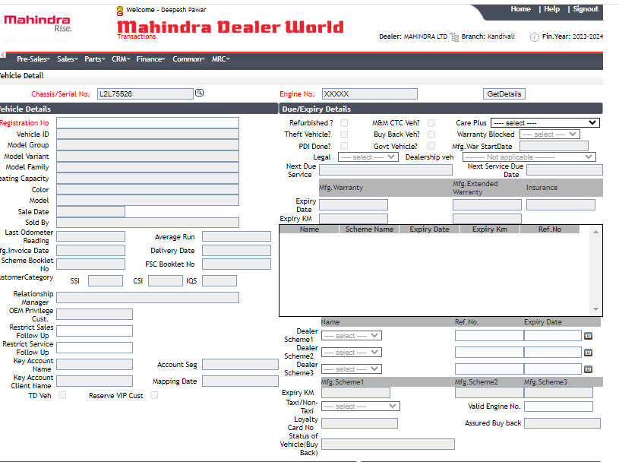
Now click on “GetDetails”

Slide 8
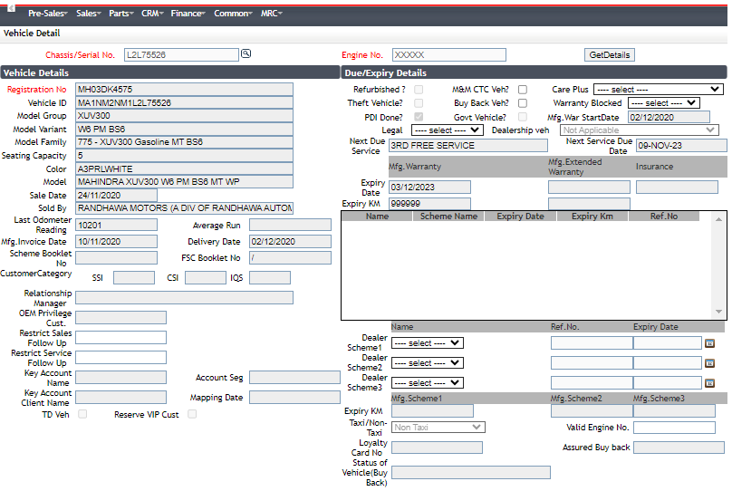
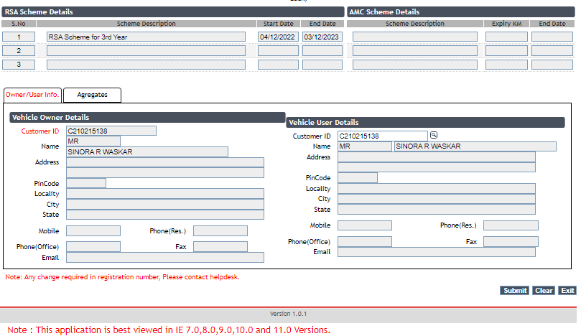
In this page we will able to see
1: Vehicle number
2: Vehicle ID
3: Vehicle details like (Model, Variant, capacity, Dealers details)
4: RSA and warranty & extended warranty

Slide 9
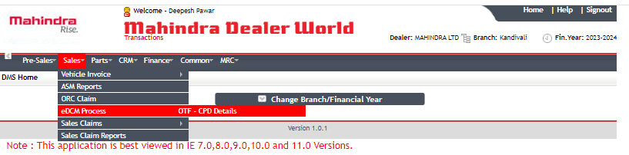
How to check OTF status
OTF: “Order Taking form” (Cust gets OTF number once the vehicle is Booked.
Step:
1: Click on “DMS”
2: Then “Sales”
3: Select “eDCM Process” from dropdown
4: click on “OTF – CPD details”

Slide 10
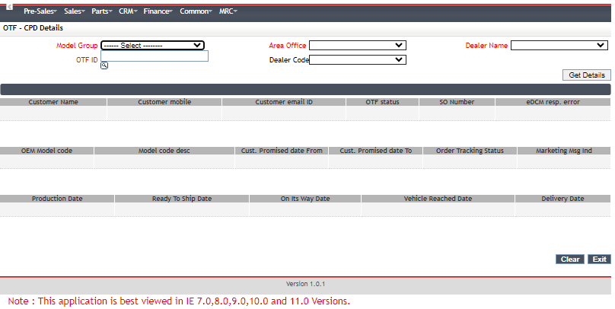
We need below details to check the OTF status
OTF ID
Model Group
Area office
Dealer Name

Slide 11
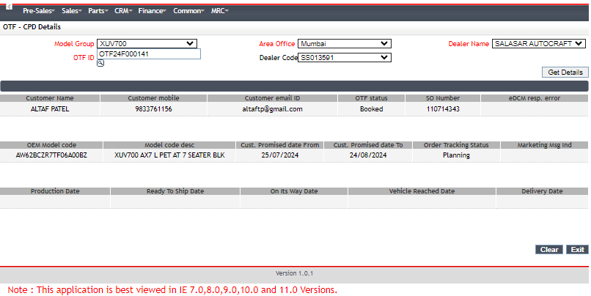
We will get the details Customer name, number, email ID
1: Order tracking status is the current status of vehicle
2: Cust. Promised date is need to share with the customer (only month and year)

Slide 12
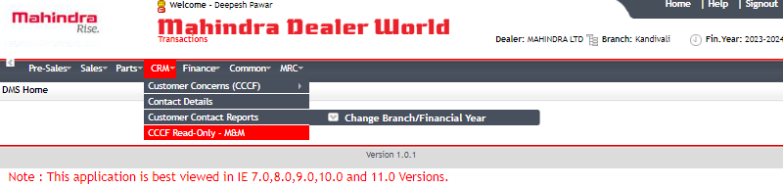
DMS – How to check CF status
Follow the below steps to check CF status
1: DMS
2: CRM
3: Click on “CCCF Read- only – M&M”

Slide 13
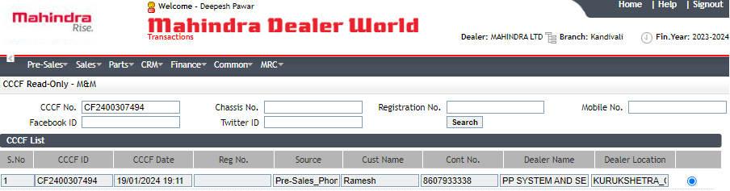
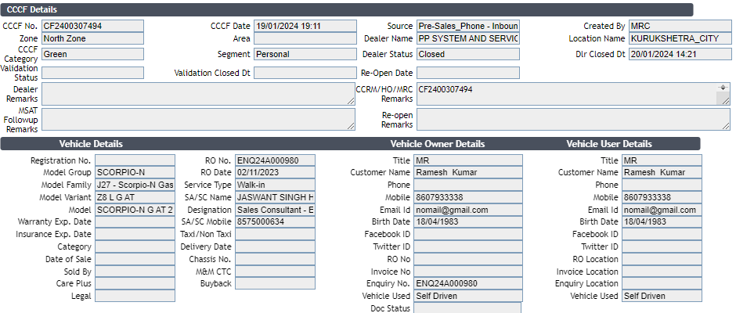
Step to check the CF status
1: Put the CF number in “CCCF No.”
2: Click on “Search”
(We will able to see the dealer remarks and complaint status)

Slide 14
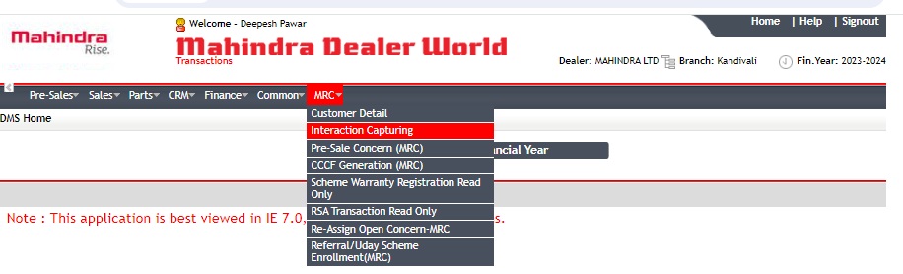
Please follow the below step
Click on “DMS”
Then click MRC
Select “Interaction Capturing”

Slide 15
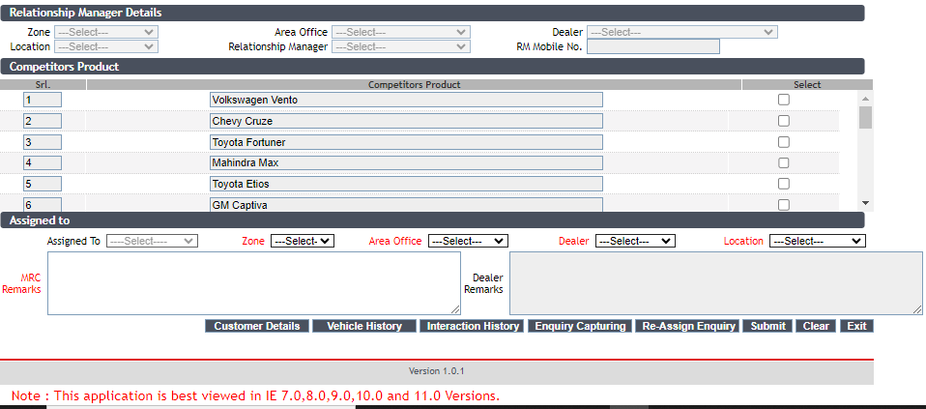
DMS – How to check “Service history”
Click on “Vehicle History”
(We will able to see all service related information including service center name, date and service in detail

Slide 16
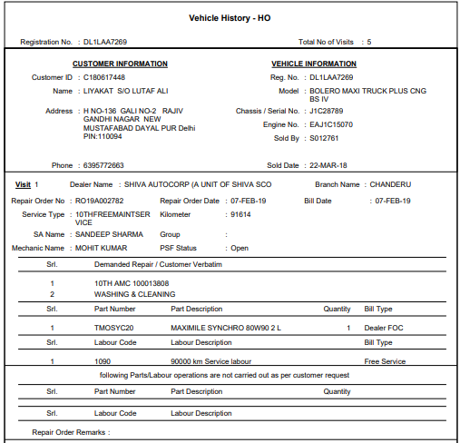

Slide 17
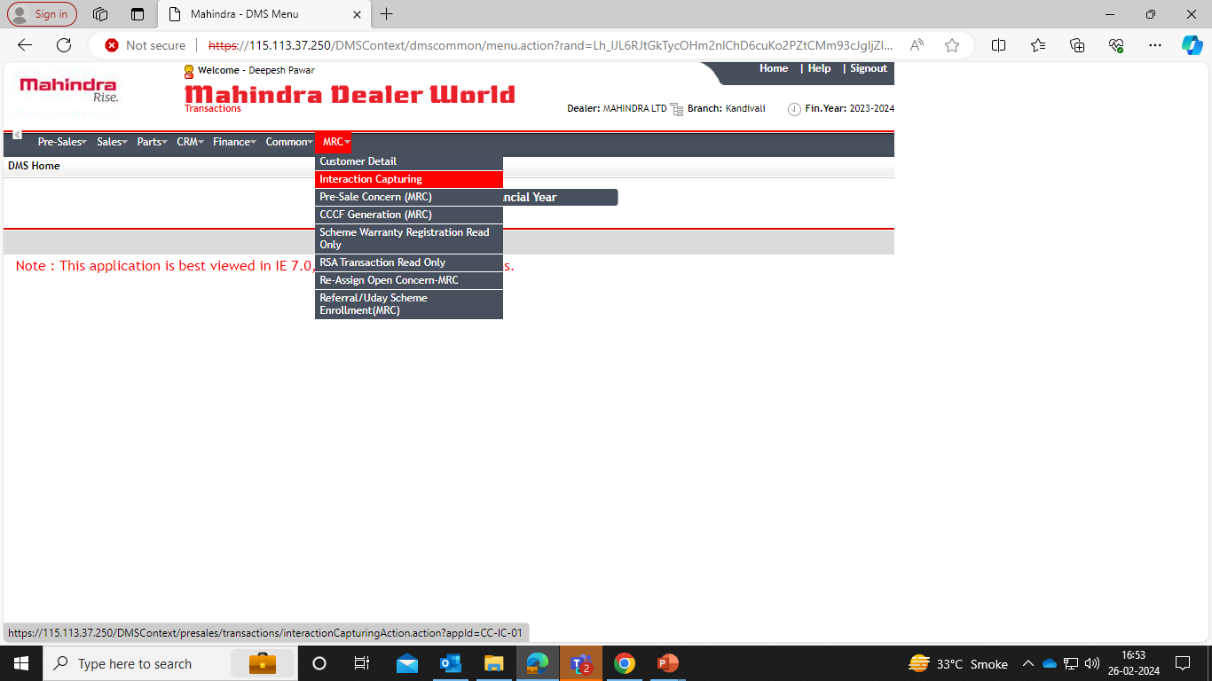
DMS – How to check “Interaction Status – Open or Close”
Steps to check the vehicle details
1: Click MRC & go to interaction tab to proceed further

Slide 18
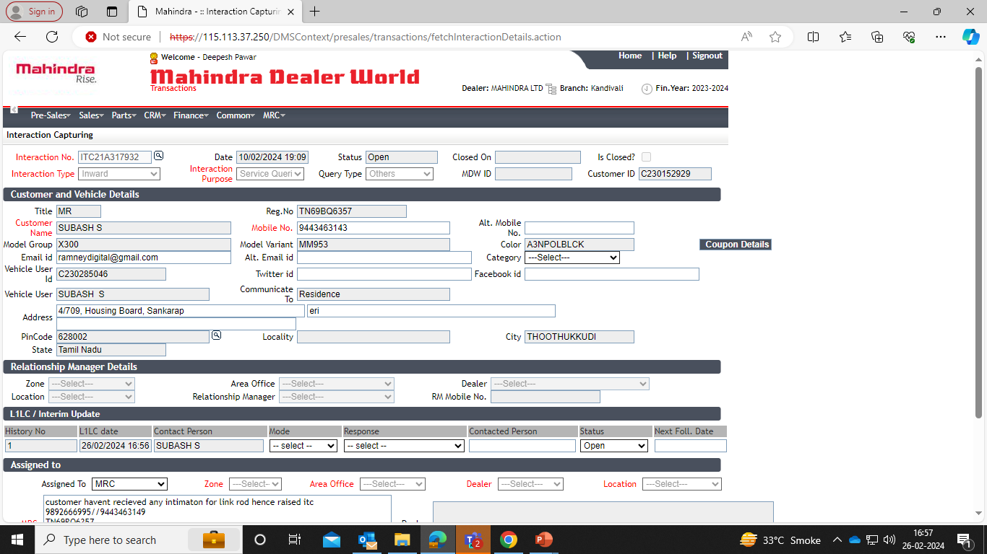
DMS – How to check “Interaction Status – Open or Close”
Steps to check the vehicle details
2: Click on interaction number and check the Status (Open or Closed)

Slide 19
DMS – How to generate an “Interaction”
Steps to check the vehicle details
1: Click MRC & tab on interaction capturing

Slide 20
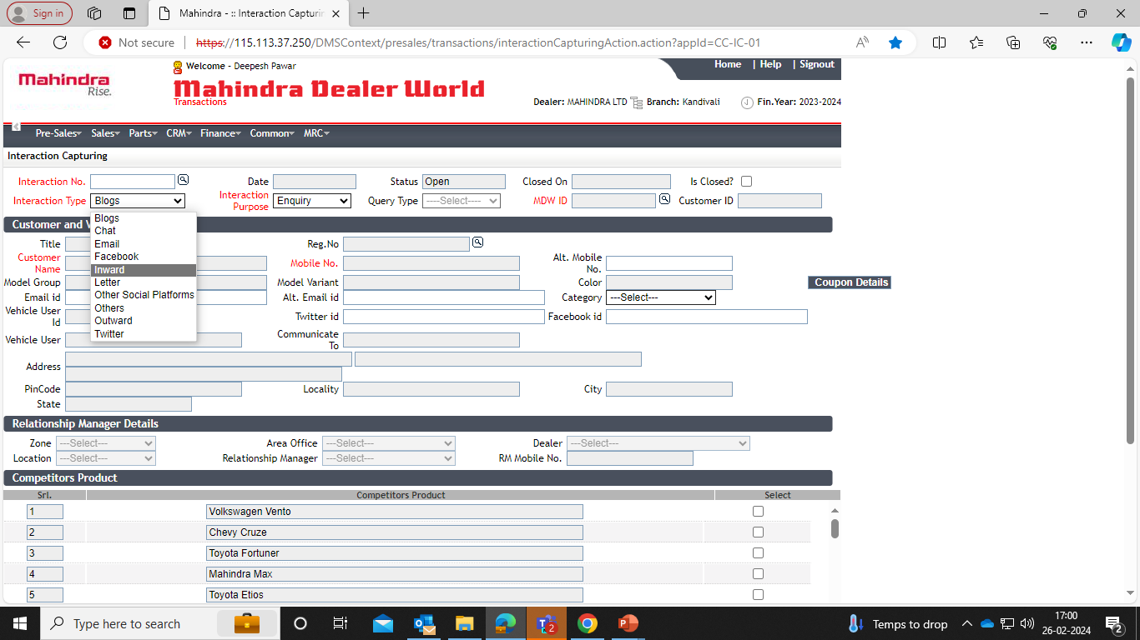
DMS – How to generate an “Interaction”
Steps to check the vehicle details
2: Click on the interaction type as ‘Inward’

Slide 21
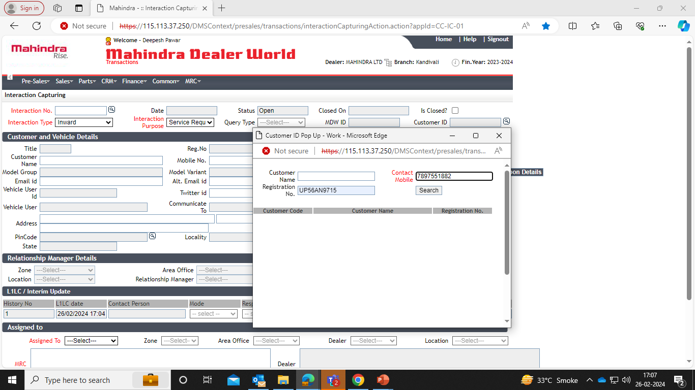
DMS – How to generate an “Interaction”
Steps to check the vehicle details
3: Click on the interaction purpose as ‘Service Request or Sales as per the call scenario’
4: Search for the Customer ID & enter Vehicle registration and Contact number & search

Slide 22
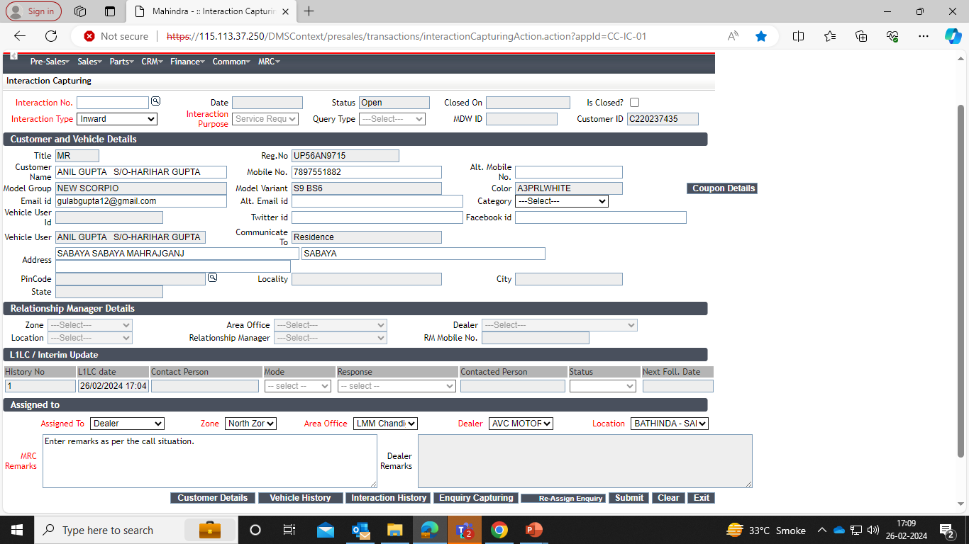
DMS – How to generate an “Interaction”
Steps to check the vehicle details
5: Add ‘remarks’ & click on ‘Submit’ to generate the Interaction

Slide 23
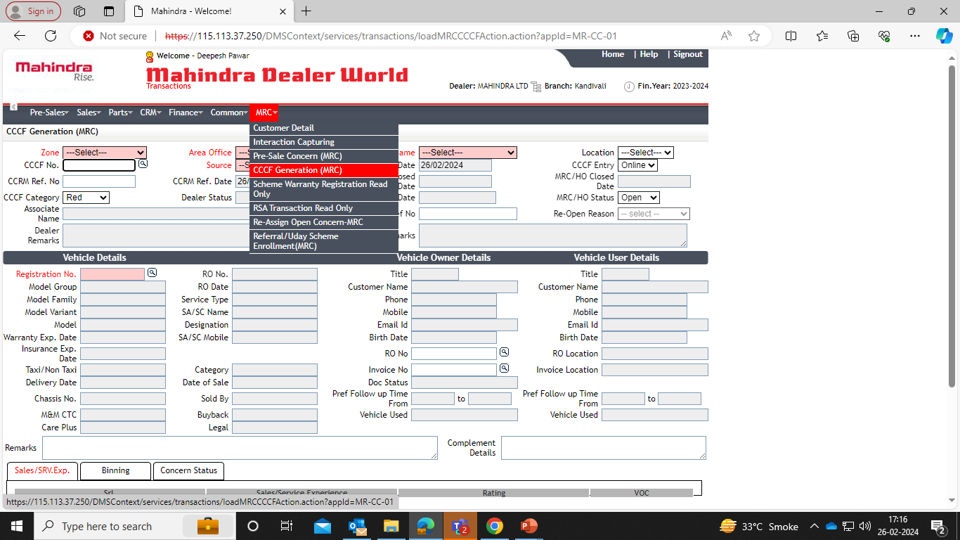
DMS – How to generate “CCCF”
Steps to check the vehicle details
1: Click MRC & tab on CCCF Generation

Slide 24
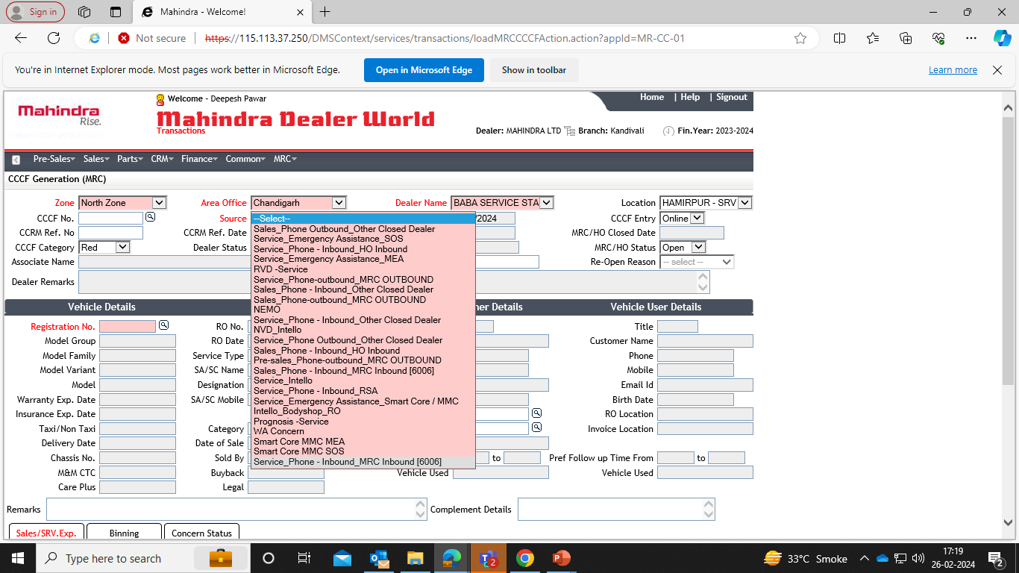
DMS – How to generate “CCCF”
Steps to check the vehicle details
2: Select Zone, Area Office, Dealer Name, Location & select source as Service or Sales as per call scenario.
IMPORTANT: For service category select Inbound_MRC_Inbound (60060

Slide 25
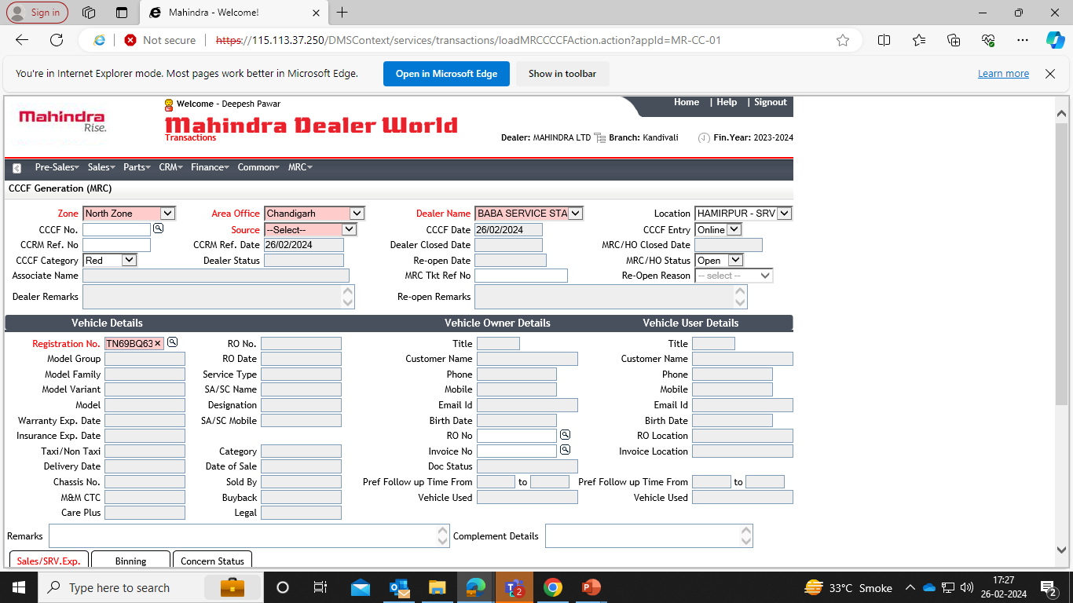
DMS – How to generate “CCCF”
Steps to check the vehicle details
3: Type registration number & tab to search

Slide 26
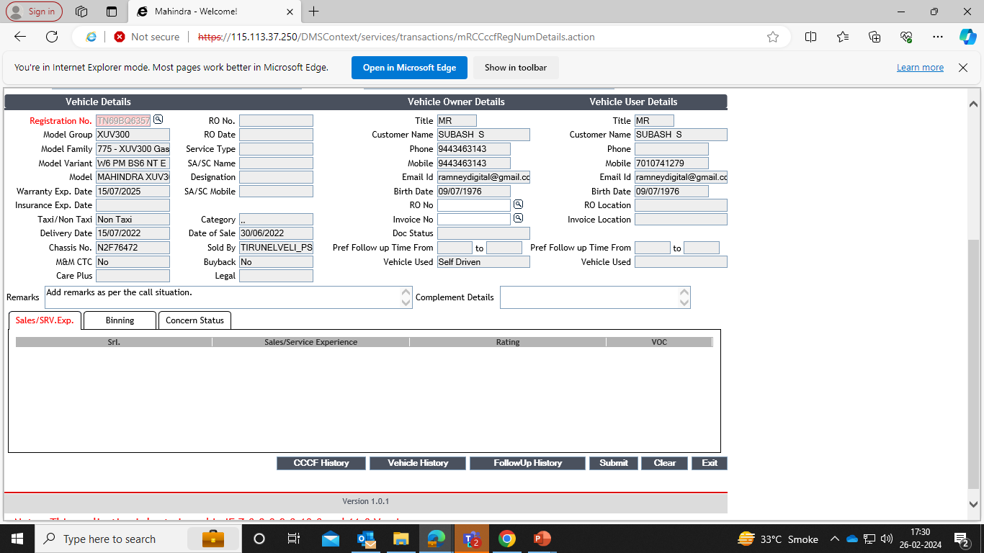
DMS – How to generate “CCCF”
Steps to check the vehicle details
4: Add ‘remarks’ & click on ‘Submit’ to generate the Interaction

Slide 27
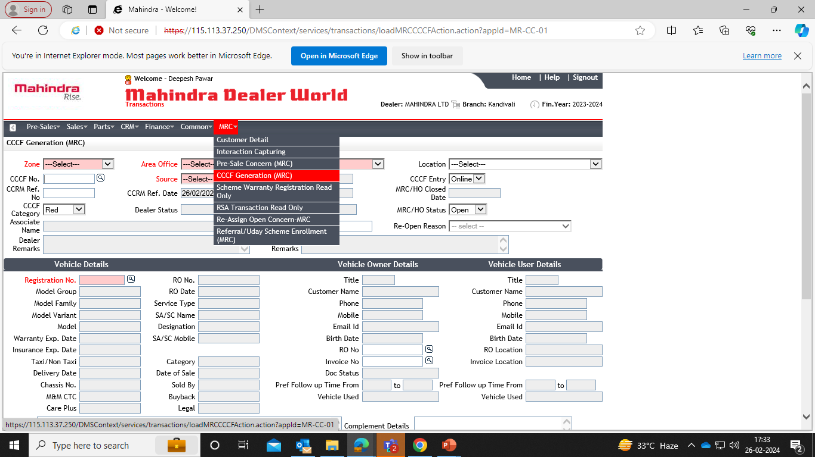
DMS – How to re-open “CCCF”
Steps to check the vehicle details
1: Click MRC & tab on CCCF Generation

Slide 28
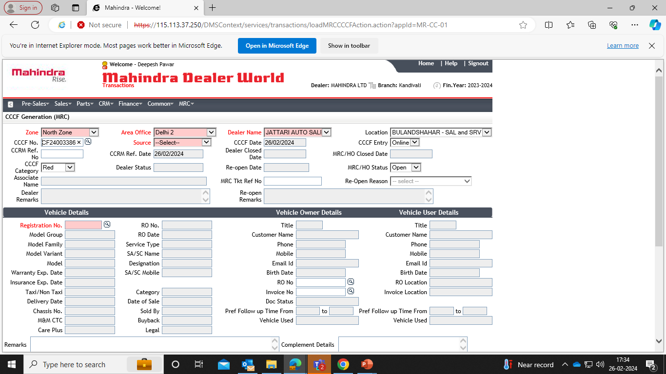
DMS – How to re-open “CCCF”
Steps to check the vehicle details
2: Select Zone, Area Office, Dealer Name, Location & select source as Service or Sales as per call scenario.
IMPORTANT: Enter CCCF number

Slide 29
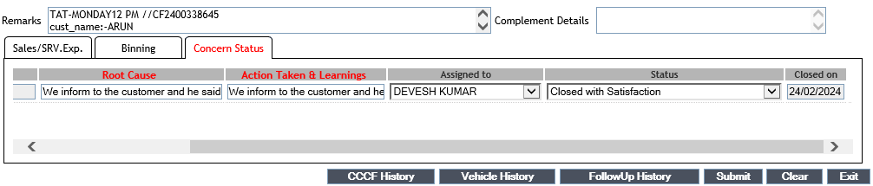
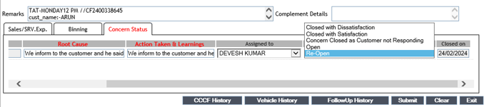
DMS – How to re-open “CCCF”
Steps to check the vehicle details
3: Click on ‘Concern Status’
4: To change the CCCF status from Closed with Satisfied to Re-Open

Slide 30
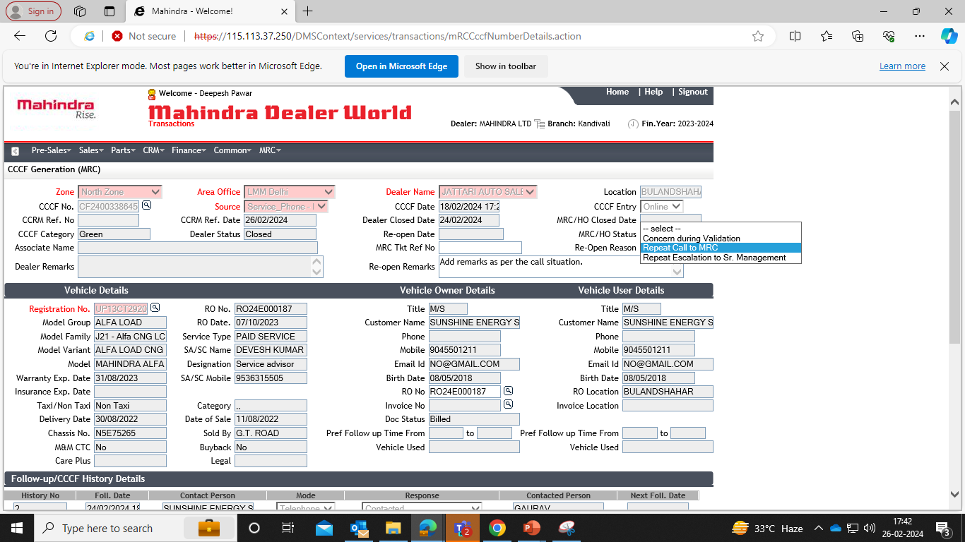
DMS – How to re-open “CCCF”
Steps to check the vehicle details
5: Scroll up to Click to update the Re-Open reason
IMPORTANT: Always select Repeat Call to MRC

Slide 31
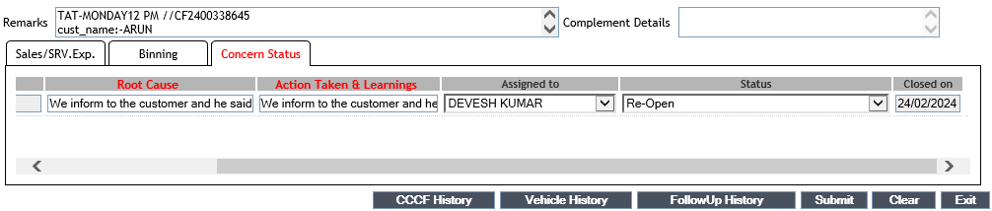
DMS – How to re-open “CCCF”
Steps to check the vehicle details
6: Click on ‘Submit’ to Re-Open the CCCF

Slide 32
Mandatory check before re-opening CCCF
Any CCCF closed within 30 days with remarks updated as ‘’customer satisfied” can be re-open as per customer’s request.
Any CCCF closed after 30 days irrespective same, or any new concern/customer satisfied or dissatisfied create new CCCF.
Any CCCF closed within 30 days with remarks updated as “customer dissatisfied” cannot be re-open within 30 days.

